Slide 1

Coexistence of many species in random ecosystems
by Carlos A. Serván, et al. (2018)
FRANCESCO FONTANA
francesco.fontana.10@studenti.unipd.it
April 29 , 2022

Slide 2
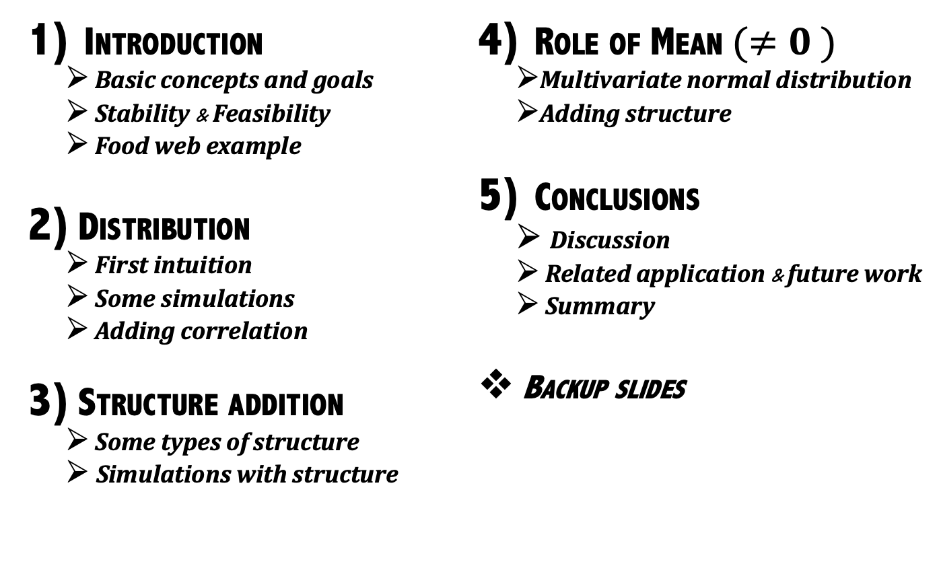
Table of Content
Introduction
Basic concepts and goals
Stability & Feasibility
Food web example
Distribution
First intuition
Some simulations
Adding correlation
Structure addition
Some types of structure
Simulations with structure
Role of Mean$(≠0 )$
Multivariate normal distribution
Adding structure
Conclusions
Discussion
Related application & future work
Summary
Backup slides

Slide 3
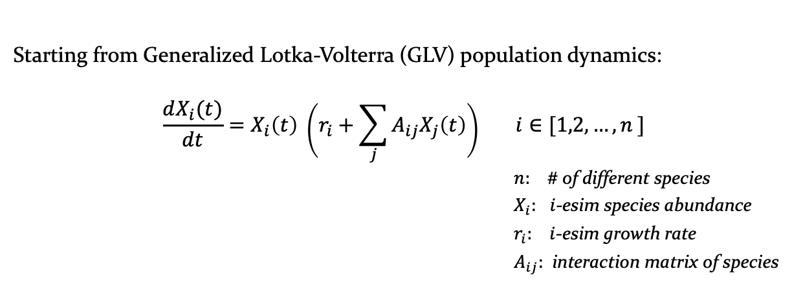
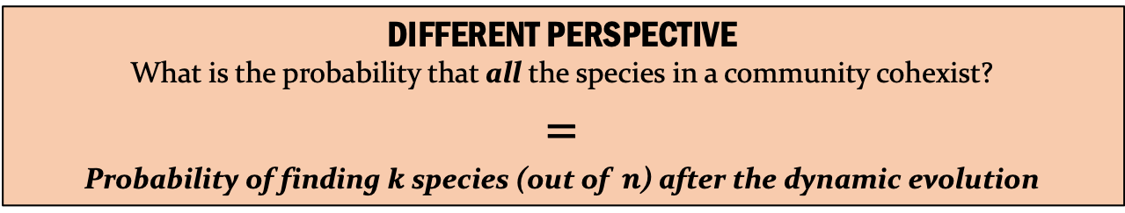
Introduction
Starting from Generalized Lotka-Volterra (GLV) population dynamics:
$$\frac{dX_{i}(t)}{dt}=X_{i}\left(t\right) \left(r_{i}+\sum_{j}{A_{ij}X_{j}\left(t\right)}\right) i∈[1,2,…,n ]$$
$n:$ # of different species
$X_{i}:$ $i$-esim species abundance
$r_{i}:$ $i$-esim growth rate
$A_{ij}:$ interaction matrix of species
[1]
PROBLEMS:
difficult to manage with a lot of species → parameters fine tuning
we observe only a portions (pruned by dynamics) instead of the entire species’ pool
DIFFERENT PERSPECTIVE
What is the probability that all the species in a community cohexist?
=
Probability of finding $k$ species (out of $n$) after the dynamic evolution
INTRODUCTION

Slide 4
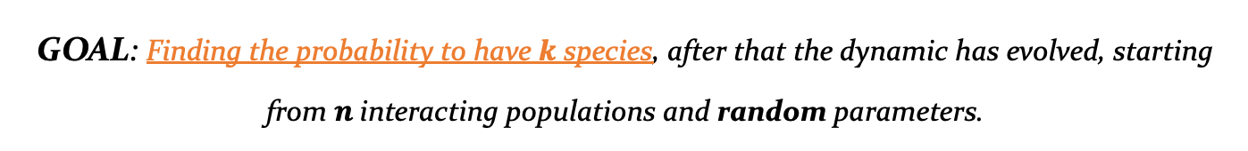

Basic concepts & Goals
GOAL: Finding the probability to have $k$ species, after that the dynamic has evolved, starting from $n$interacting populations and random parameters.
$$P\left(k | n\right)$$
We need two important feature:
COHEXISTANCE
STABILITY
INTRODUCTION

Slide 5

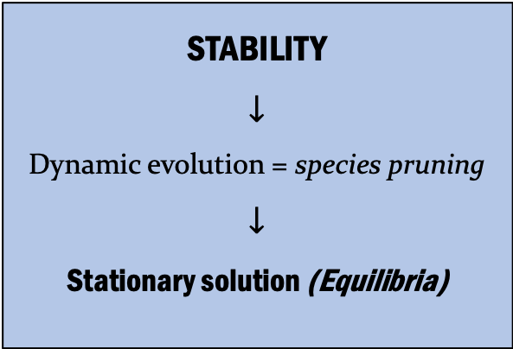
Basic concepts & Goals
GOAL: Finding the probability to have $k$ species ,after that the dynamic has evolved, starting from $n$interacting populations and random parameters.
$$P\left(k | n\right)$$
We need two important feature:
COHEXISTANCE
STABILITY
$$↓$$
Dynamic evolution = species pruning
$$↓$$
Stationary solution (Equilibria)
INTRODUCTION

Slide 6
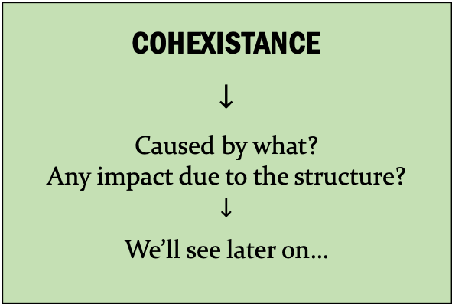
Basic concepts & Goals
GOAL: Finding the probability to have $k$ species ,after that the dynamic has evolved, starting from $n$interacting populations and random parameters.
$$P\left(k | n\right)$$
We need two important feature:
COHEXISTANCE
$$↓$$
Caused by what?
Any impact due to the structure?
$$↓$$
We’ll see later on…
STABILITY
$$↓$$
Dynamic evolution = species pruning
$$↓$$
Stationary solution (Equilibria)
INTRODUCTION

Slide 7
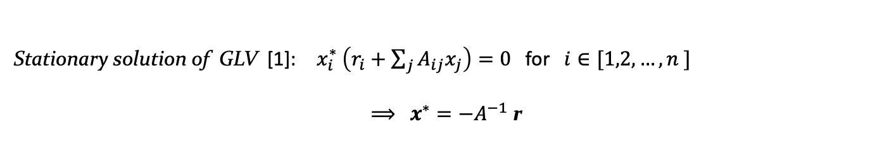
Stability & Feasibility
Stationary solution of GLV [1]: $x_{i}^{∗} \left(r_{i}+\sum_{j}{A_{ij}x_{j}}\right)=0$ for $i∈[1,2,…,n ]$
$⟹$ $x^{∗}=−A^{−1}$ r
[2]
[3]
INTRODUCTION

Slide 8
Stability & Feasibility
Stationary solution of GLV [1]: $x_{i}^{∗} \left(r_{i}+\sum_{j}{A_{ij}x_{j}}\right)=0$ for $i∈[1,2,…,n ]$
$⟹$ $x^{∗}=−A^{−1}$ r
[2]
[3]
Lyapunov stability:
diagonally stable interaction matrix A
Equilibrium stability
DEFINITION: A generic matrix $A$ is Lyapunov diagonally stable (LDS) if there exists a positive diagonal matrix $D$such that $\left( DA + A^{T}D\right)$ is negative definite.
INTRODUCTION

Slide 9
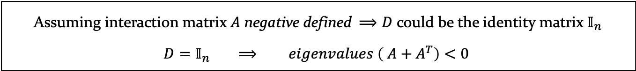
Stability & Feasibility
Stationary solution of GLV [1]: $x_{i}^{∗} \left(r_{i}+\sum_{j}{A_{ij}x_{j}}\right)=0$ for $i∈[1,2,…,n ]$
$⟹$ $x^{∗}=−A^{−1}$ r
[2]
[3]
Lyapunov stability:
diagonally stable interaction matrix A
Equilibrium stability
DEFINITION: A generic matrix $A$ is Lyapunov diagonally stable (LDS) if there exists a positive diagonal matrix $D$such that $\left( DA + A^{T}D\right)$is negative definite.
Assuming interaction matrix $A$ negative defined $⟹D$ could be the identity matrix $𝕀_{n}$
$$D=𝕀_{n} ⟹ eigenvalues \left( A+A^{T}\right)<0$$
Why LDS ?
INTRODUCTION

Slide 10
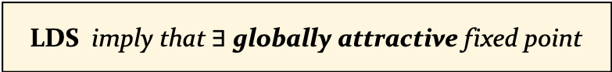
Stability & Feasibility
Stationary solution of GLV [1]: $x_{i}^{∗} \left(r_{i}+\sum_{j}{A_{ij}x_{j}}\right)=0$ for $i∈[1,2,…,n ]$
$⟹$ $x^{∗}=−A^{−1}$ r
[2]
[3]
Lyapunov stability:
diagonally stable interaction matrix A
Equilibrium stability
DEFINITION: A generic matrix $A$ is Lyapunov diagonally stable (LDS) if there exists a positive diagonal matrix $D$such that $\left( DA + A^{T}D\right)$is negative definite.
Assuming interaction matrix $A$ negative defined $⟹D$ could be the identity matrix $𝕀_{n}$
$$D=𝕀_{n} ⟹ eigenvalues \left( A+A^{T}\right)<0$$
Why LDS ?
LDS imply that $∃$ globally attractive fixed point
Non–invasible solution
GOAL: Distribution of non-invasible fixed point?
INTRODUCTION

Slide 11
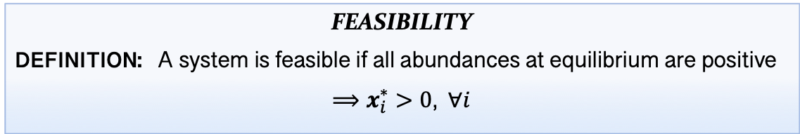
Stability & Feasibility
FEASIBILITY
DEFINITION: A system is feasible if all abundances at equilibrium are positive
$⟹x_{i}^{∗}>0$, $∀i$
stability & feasibility how are related to coexistance?
Feasibility is necessary
Stability, if added, completes the hypothesis to study coexistence
INTRODUCTION

Slide 12
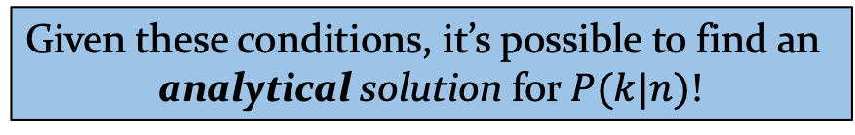
Stability & Feasibility
FEASIBILITY
DEFINITION: A system is feasible if all abundances at equilibrium are positive
$⟹x_{i}^{∗}>0$, $∀i$
stability & feasibility how are related to coexistance?
Feasibility is necessary
Stability, if added, completes the hypothesis to study coexistence
Given these conditions, it’s possible to find an
analytical solution for $P(k|n)$!
INTRODUCTION

Slide 13
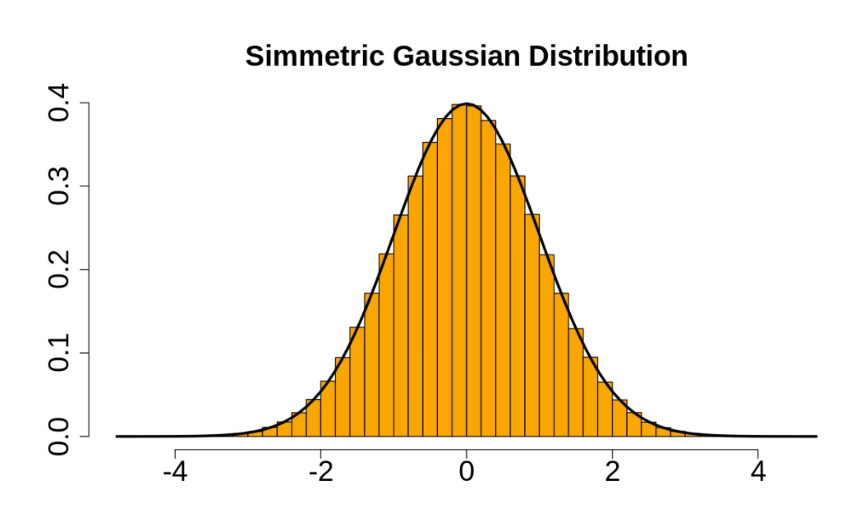
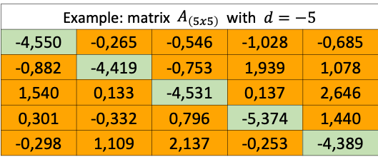
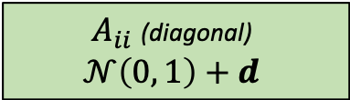
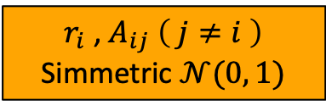
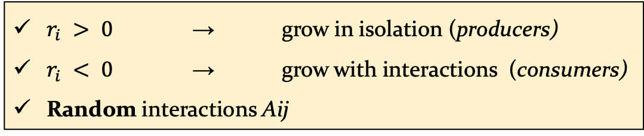
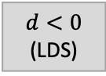
Food Web Example
Considering the GLV system of equations [1], the dynamic evolves with:
$r_{i} > 0$ → grow in isolation (producers)
$r_{i} < 0$ → grow with interactions (consumers)
Random interactions Aij
$r_{i}$ , $A_{ij} \left( j≠i \right)$
Simmetric $𝒩(0, 1)$
$A_{ii}$ (diagonal)
$$𝒩\left(0, 1\right)+d$$
$$d<0$$
(LDS)
Example: matrix ${ A}_{\left(5x5\right)}$ with $d=−5$
-4,550 | -0,265 | -0,546 | -1,028 | -0,685
-0,882 | -4,419 | -0,753 | 1,939 | 1,078
1,540 | 0,133 | -4,531 | 0,137 | 2,646
0,301 | -0,332 | 0,796 | -5,374 | 1,440
-0,298 | 1,109 | 2,137 | -0,253 | -4,389
INTRODUCTION

Slide 14
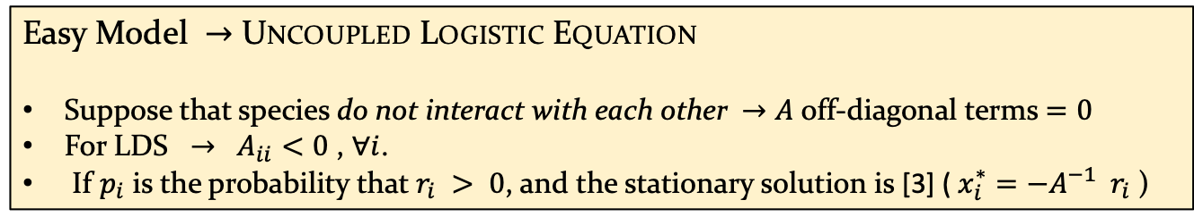
Distribution – first intuition
Easy Model $→$ Uncoupled Logistic Equation
Suppose that species do not interact with each other $→A$ off-diagonal terms $=0$
For LDS $→ A_{ii}<0$ , $∀i$.
If $p_{i}$ is the probability that $r_{i} > 0$, and the stationary solution is [3] ( $x_{i}^{∗}=−A^{−1}{ r}_{i}$ )
DISTRIBUTION

Slide 15
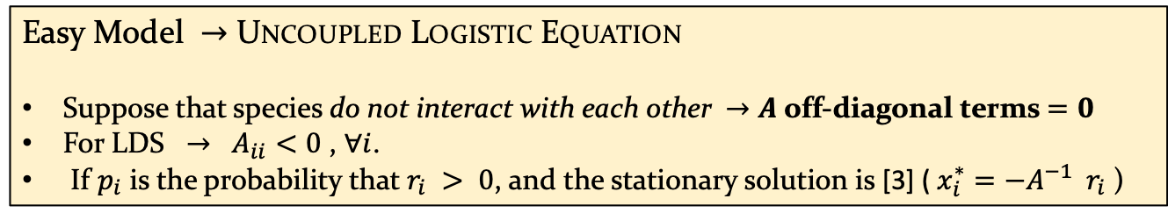

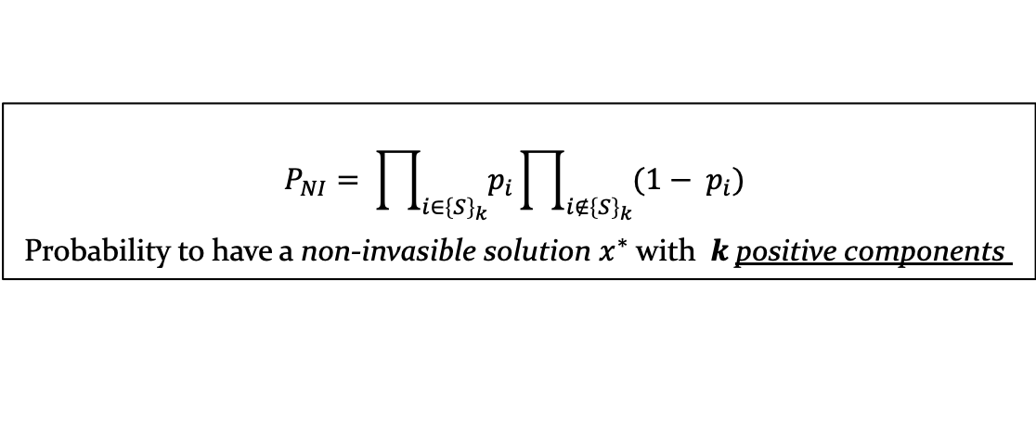
Distribution – first intuition
Easy Model $→$ Uncoupled Logistic Equation
Suppose that species do not interact with each other $→A$ off-diagonal terms $=0$
For LDS $→ A_{ii}<0$ , $∀i$.
If $p_{i}$ is the probability that $r_{i} > 0$, and the stationary solution is [3] ( $x_{i}^{∗}=−A^{−1}{ r}_{i}$ )
$$P_{NI}= \prod_{i∈{\left\{S\right\}}_{k}}{p_{i}}\prod_{i∉{\left\{S\right\}}_{k}}{{(1− p}_{i}) }$$
Probability to have a non-invasible solution $x^{∗}$ with $k$positive components
If $r_{i}$ distribution is symmetric $→$ $p_{i} =\frac{1}{2} ⟹P_{NI}=\frac{1}{2^{n}}$
DISTRIBUTION

Slide 16
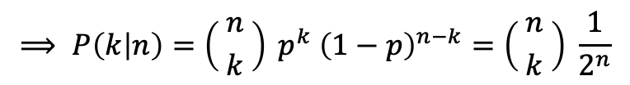
Distribution – first intuition
Easy Model $→$ Uncoupled Logistic Equation
Suppose that species do not interact with each other $→A$ off-diagonal terms $=0$
For LDS $→ A_{ii}<0$ , $∀i$.
If $p_{i}$ is the probability that $r_{i} > 0$, and the stationary solution is [3] ( $x_{i}^{∗}=−A^{−1}{ r}_{i}$ )
$$P_{NI}= \prod_{i∈{\left\{S\right\}}_{k}}{p_{i}}\prod_{i∉{\left\{S\right\}}_{k}}{{(1− p}_{i}) }$$
Probability to have a non-invasible solution $x^{∗}$ with $k$positive components
If $r_{i}$ distribution is symmetric $→$ $p_{i} =\frac{1}{2} ⟹P_{NI}=\frac{1}{2^{n}}$
Binomial distribution
$$⟹ P\left(k | n\right)=\left({ n \atop k}\right) p^{k} {\left(1−p\right)}^{n−k}=\left({ n \atop k}\right) \frac{1}{2^{n}}$$
… but is Binomial also when species interact??
DISTRIBUTION

Slide 17
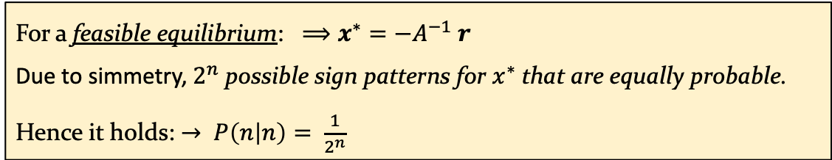
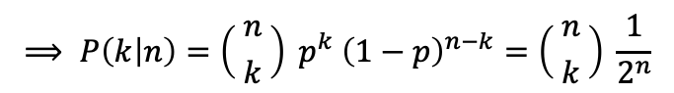
Distribution – first intuition
Binomial distribution
… but is Binomial also when species interact??
$$⟹ P\left(k | n\right)=\left({ n \atop k}\right) p^{k} {\left(1−p\right)}^{n−k}=\left({ n \atop k}\right) \frac{1}{2^{n}}$$
YES
For a feasible equilibrium: $⟹x^{∗}=−A^{−1} r$
Due to simmetry, $2^{n}$ possible sign patterns for $x^{∗}$that are equally probable.
Hence it holds: $→ P\left(n | n\right)= \frac{1}{2^{n}}$
DISTRIBUTION

Slide 18
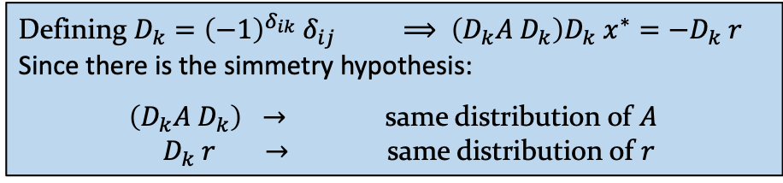
Distribution – first intuition
Binomial distribution
… but is Binomial also when species interact??
$$⟹ P\left(k | n\right)=\left({ n \atop k}\right) p^{k} {\left(1−p\right)}^{n−k}=\left({ n \atop k}\right) \frac{1}{2^{n}}$$
YES
For a feasible equilibrium: $⟹x^{∗}=−A^{−1} r$
Due to simmetry, $2^{n}$ possible sign patterns for $x^{∗}$that are equally probable.
Hence it holds: $→ P\left(n | n\right)= \frac{1}{2^{n}}$
Defining $D_{k}={\left(−1\right)}^{δ_{ik}} δ_{ij}$ $⟹ \left(D_{k}A D_{k}\right)D_{k} x^{∗}=−D_{k} r$
Since there is the simmetry hypothesis:
$\left(D_{k}A D_{k}\right) →$ same distribution of $A$
$D_{k} r$ $→$ same distribution of $r$
DISTRIBUTION

Slide 19
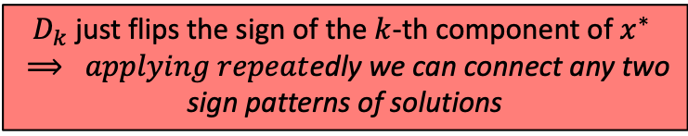
Distribution
Binomial distribution
… but is Binomial also when species interact??
$$⟹ P\left(k | n\right)=\left({ n \atop k}\right) p^{k} {\left(1−p\right)}^{n−k}=\left({ n \atop k}\right) \frac{1}{2^{n}}$$
YES
For a feasible equilibrium: $⟹x^{∗}=−A^{−1} r$
Due to simmetry, $2^{n}$ possible sign patterns for $x^{∗}$that are equally probable.
Hence it holds: $→ P\left(n | n\right)= \frac{1}{2^{n}}$
Defining $D_{k}={\left(−1\right)}^{δ_{ik}} δ_{ij}$ $⟹ \left(D_{k}A D_{k}\right)D_{k} x^{∗}=−D_{k} r$
Since there is the simmetry hypothesis:
$\left(D_{k}A D_{k}\right) →$ same distribution of $A$
$D_{k} r$ $→$ same distribution of $r$
$D_{k}$ just flips the sign of the $k$-th component of $x^{∗}$ $⟹ applying repeat$edly we can connect any two
sign patterns of solutions
DISTRIBUTION

Slide 20
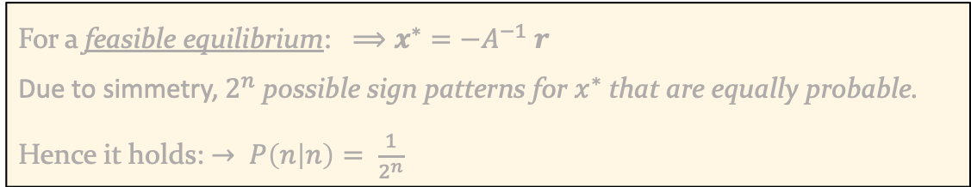
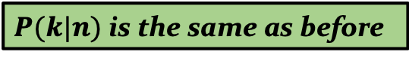
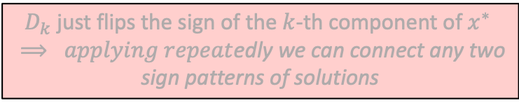
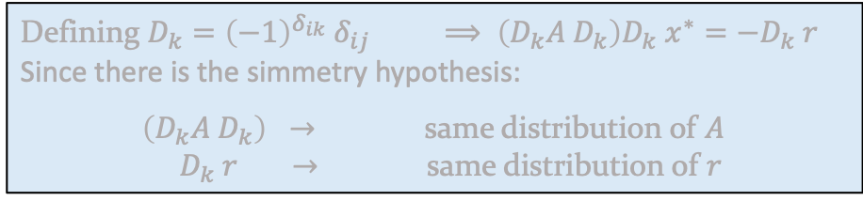
Distribution – first intuition
Binomial distribution
… but is Binomial also when species interact??
$$⟹ P\left(k | n\right)=\left({ n \atop k}\right) p^{k} {\left(1−p\right)}^{n−k}=\left({ n \atop k}\right) \frac{1}{2^{n}}$$
YES
For a feasible equilibrium: $⟹x^{∗}=−A^{−1} r$
Due to simmetry, $2^{n}$ possible sign patterns for $x^{∗}$that are equally probable.
Hence it holds: $→ P\left(n | n\right)= \frac{1}{2^{n}}$
Defining $D_{k}={\left(−1\right)}^{δ_{ik}} δ_{ij}$ $⟹ \left(D_{k}A D_{k}\right)D_{k} x^{∗}=−D_{k} r$
Since there is the simmetry hypothesis:
$\left(D_{k}A D_{k}\right) →$ same distribution of $A$
$D_{k} r$ $→$ same distribution of $r$
$D_{k}$ just flips the sign of the $k$-th component of $x^{∗}$ $⟹ applying repeat$edly we can connect any two
sign patterns of solutions
$P(k|n)$ is the same as before
DISTRIBUTION

Slide 21
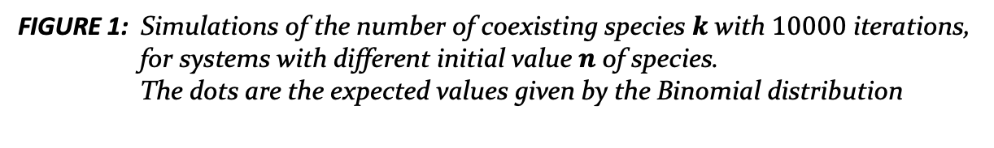
Some simulations
FIGURE 1: Simulations of the number of coexisting species $k$ with $10000$ iterations, for systems with different initial value $n$ of species.
The dots are the expected values given by the Binomial distribution
DISTRIBUTION

Slide 22
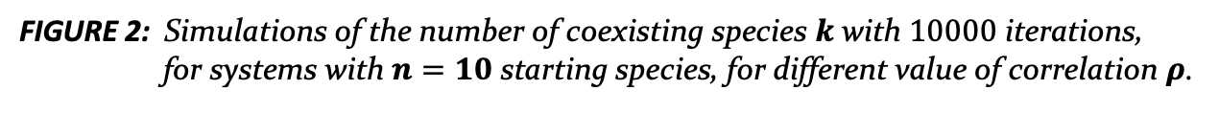
Adding correlation
FIGURE 2: Simulations of the number of coexisting species $k$ with $10000$ iterations, for systems with $n=10$ starting species, for different value of correlation $ρ$.
DISTRIBUTION

Slide 23
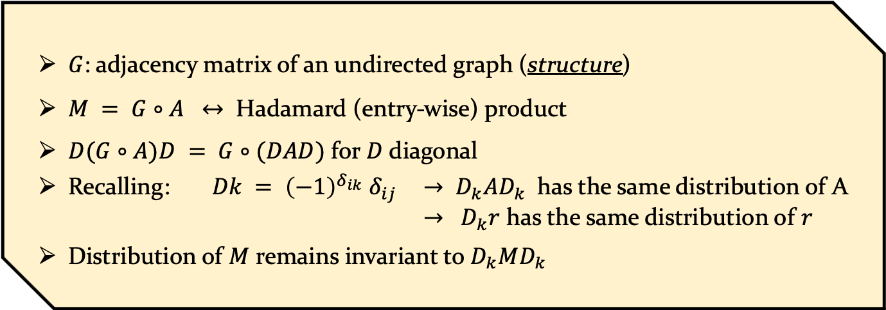
Structure Addition
$G$: adjacency matrix of an undirected graph (structure)
$M = G∘A$ $↔$ Hadamard (entry-wise) product
$D(G∘A)D = G∘(DAD)$ for $D$ diagonal
Recalling: $Dk = {\left(−1\right)}^{δ_{ik}} δ_{ij}$ $→ D_{k}AD_{k}$ has the same distribution of A
$→ D_{k}r$ has the same distribution of $r$
Distribution of $M$ remains invariant to $D_{k}MD_{k}$
Adding network structure does not change the overall probability distribution
STRUCTURE ADDITION

Slide 24
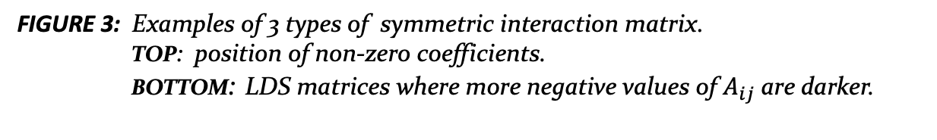
Some types of structure
FIGURE 3: Examples of 3 types of symmetric interaction matrix.
TOP: position of non-zero coefficients.
BOTTOM: LDS matrices where more negative values of $A_{ij}$are darker.
STRUCTURE ADDITION

Slide 25
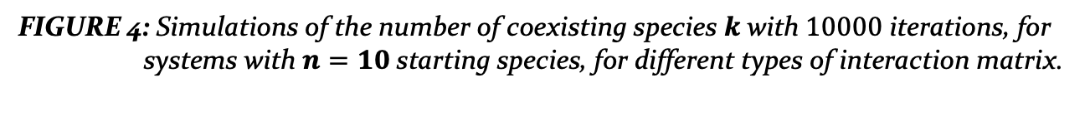
Simulations with structure
FIGURE 4: Simulations of the number of coexisting species $k$ with $10000$ iterations, for
systems with $n=10$starting species, for different types of interaction matrix.
STRUCTURE ADDITION

Slide 26


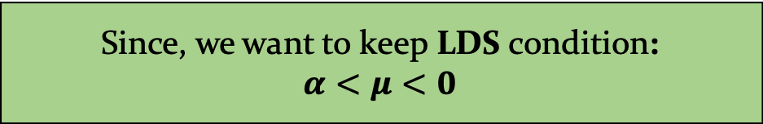
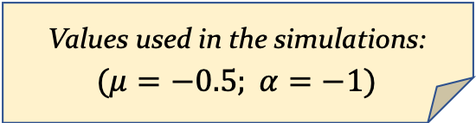
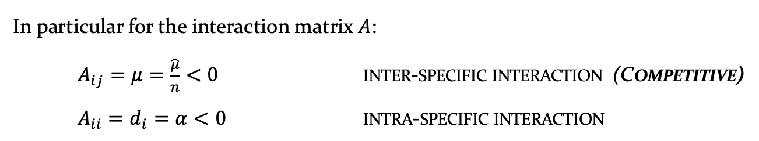
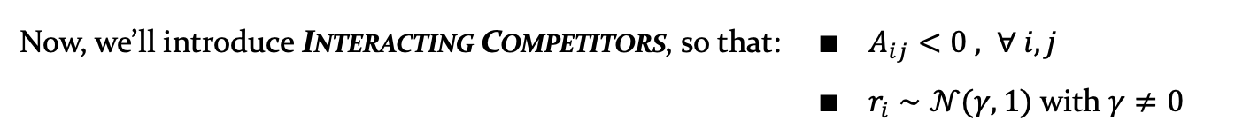
Role of Mean $(≠0 )$
Now, we’ll introduce Interacting Competitors, so that: $∎ A_{ij}<0 , ∀ i,j$
$∎ r_{i}∼$ $𝒩(γ, 1)$ with $γ≠0$
In particular for the interaction matrix $A$:
$A_{ij}=μ=\frac{\hat{μ}}{n}<0$ inter-specific interaction (Competitive)
$A_{ii}=d_{i}=α<0$ intra-specific interaction
!
Since, we want to keep LDS condition:
$α<μ<0$
Values used in the simulations:
$$(μ=−0.5; α=−1)$$
ROLE OF MEAN $(≠0)$

Slide 27
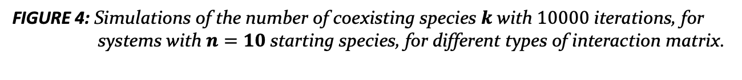
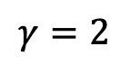
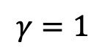
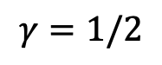
Role of Mean $(≠0 )$
$$γ=1/2$$
$$γ=1$$
$$γ=2$$
FIGURE 4: Simulations of the number of coexisting species $k$ with $10000$ iterations, for
systems with $n=10$starting species, for different types of interaction matrix.
ROLE OF MEAN $(≠0)$

Slide 28


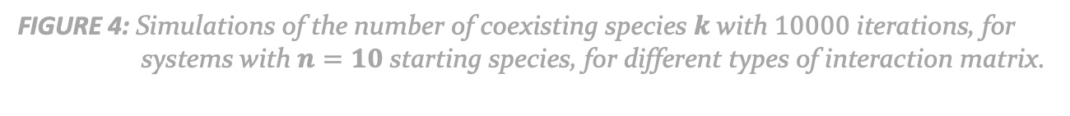
Role of Mean $(≠0 )$
$$γ=1/2$$
$$γ=1$$
$$γ=2$$
FIGURE 4: Simulations of the number of coexisting species $k$ with $10000$ iterations, for
systems with $n=10$starting species, for different types of interaction matrix.
Which distribution?
ROLE OF MEAN $(≠0)$

Slide 29
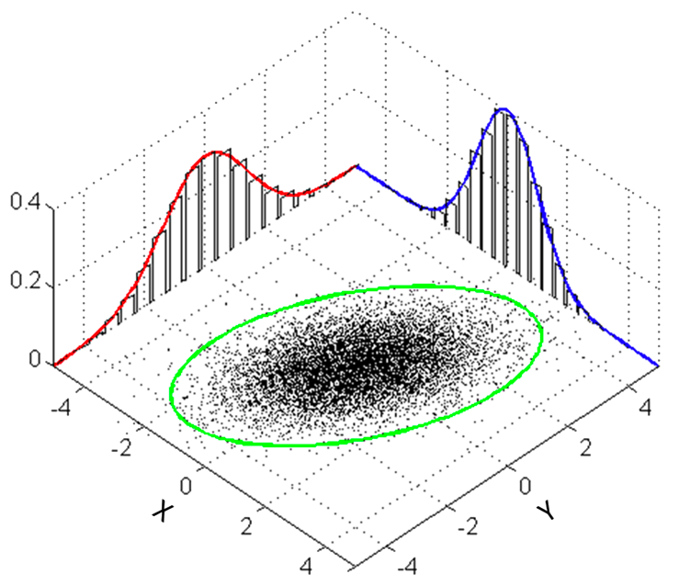
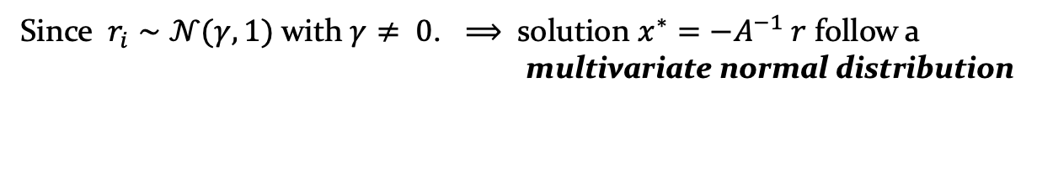
Multivariate normal distribution
Since $r_{i}∼$ $𝒩(γ, 1)$ with $γ≠ 0$. $⟹$ solution $x^{∗}=−A^{−1} r$ follow a multivariate normal distribution
ROLE OF MEAN $(≠0)$

Slide 30
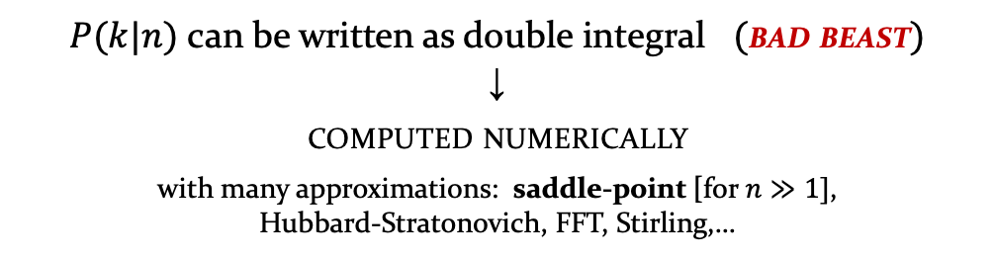
Multivariate normal distribution
Since $r_{i}∼$ $𝒩(γ, 1)$ with $γ≠ 0$. $⟹$ solution $x^{∗}=−A^{−1} r$ follow a multivariate normal distribution
$P(k|n)$ can be written as double integral $($bad beast$)$
↓
computed numerically
with many approximations: saddle-point [for $n≫1]$,
Hubbard-Stratonovich, FFT, Stirling,…
ROLE OF MEAN $(≠0)$

Slide 31
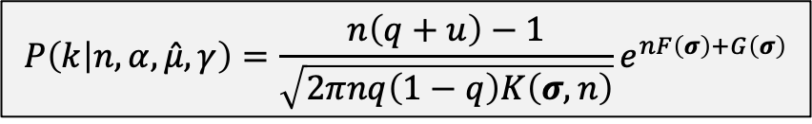
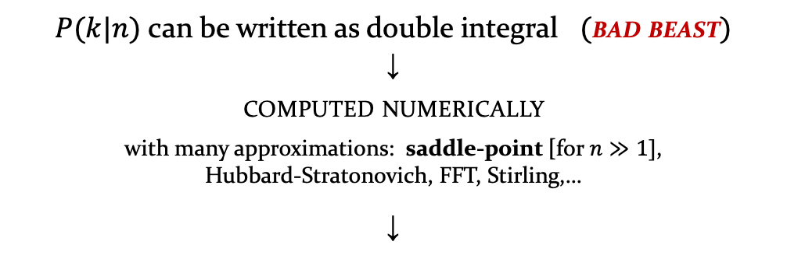
Multivariate normal distribution
Since $r_{i}∼$ $𝒩(γ, 1)$ with $γ≠ 0$. $⟹$ solution $x^{∗}=−A^{−1} r$ follow a multivariate normal distribution
$P(k|n)$ can be written as double integral $($bad beast$)$
↓
computed numerically
with many approximations: saddle-point [for $n≫1]$,
Hubbard-Stratonovich, FFT, Stirling,…
↓
$$P\left(k | n, α,\hat{μ}, γ\right)=\frac{n\left(q+u\right)−1}{\sqrt{2πnq\left(1−q\right)K\left(σ,n\right)}}e^{nF\left(σ\right)+G\left(σ\right)}$$
[4]
$• q=\frac{k}{n}$ $• u=\frac{α}{\hat{μ}}=\frac{α}{nμ} •σ=\left( q, u , v\right) •v=\frac{γ\left(α−μ\right)}{α −μ+kμ}$
ROLE OF MEAN $(≠0)$

Slide 32
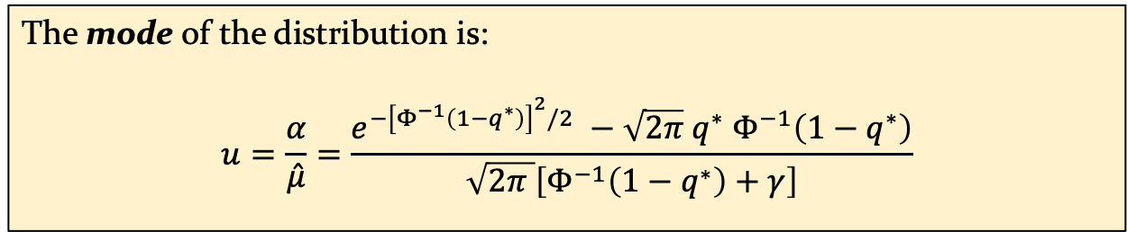
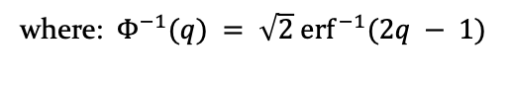

Multivariate normal distribution
The mode of the distribution is:
$$u=\frac{α}{\hat{μ}}=\frac{e^{−{\left[Φ^{−1}\left(1−q^{∗}\right)\right]}^{2}/2} −\sqrt{2π} q^{∗} Φ^{−1}\left(1−q^{∗}\right)}{\sqrt{2π }\left[Φ^{−1}\left(1−q^{∗}\right)+γ\right]}$$
[5]
where:$Φ^{−1}(q) = \sqrt{2}{ erf}^{−1}(2q − 1)$
A simple relation arises for the curve that separates left and right-skewed distributions by choosing:
$q^{∗}=1/2$ $⟹ Φ^{−1}→0$
↓
$$u=\frac{1}{\sqrt{2π}γ} ⟹ \frac{αγ}{μ}=\frac{n}{\sqrt{2π}}$$
[6]
ROLE OF MEAN $(≠0)$

Slide 33

…with structure
ROLE OF MEAN $(≠0)$

Slide 34

…with structure
ROLE OF MEAN $(≠0)$

Slide 35



Conclusions
Food web sampled $A_{ij}$ and $r_{i}$ independently
↓
generation of "bad" species $(r_{i}<0 \& A_{ij}<0)$
↓
surely extincted! $⟹$ CORRELATION
FIGURE 6: left: $ℜ(z)$ vs $ℑ(z)$ parts of eigenvalues (z) of interaction matrix $A$ ...*
right: Growth rates distribution …*
*…before and after the dynamics has reached equilibrium. (initial $n=3000$ species; survived $k=1525$species).

Slide 36
Related application & future work
Applications
Application to local communities composed of subsets of the same pool of species (metacommunities): model the distribution of the number of species found in local patches
Application to microbial communities (assembly)
CONCLUSIONS

Slide 37
Related application & future work
Applications
Application to local communities composed of subsets of the same pool of species (metacommunities): model the distribution of the number of species found in local patches
Application to microbial communities (assembly)
Future work
Consider stronger form of networks, in which also the non-zero coefficient have a pattern
Relaxing LDS condition → very challenging
Understanding the process of assembly in which communities are built
CONCLUSIONS

Slide 38




Summary
summarizing:
Large communities can stably coexist thanks to the selection imposed by the dynamical pruning of a large species pool
Successfully tested many different structures, no particular impact from network once stability is reached
Mean = $0$
Mean $≠$ $0$
$P\left( k | n \right) = Bin\left(n , \frac{1}{2} \right)$
No differences caused by the network
$P\left( k | n \right)$ not binomial
but with strong central tendency and known mode
Little effect due to network
CONCLUSIONS

Slide 40
BACKUP SLIDES

Slide 41

Other types of structure
FIGURE 7: Examples of other 3 types of symmetric interaction matrix.
BACKUP SLIDES

Slide 42


Derivation of $P\left(k | n\right)$ [mean $≠ 0$] - 1
[7]
BACKUP SLIDES

Slide 43


Derivation of $P\left(k | n\right)$ [mean $≠ 0$] - 2
[7]
[8]
BACKUP SLIDES

Slide 44


Derivation of $P\left(k | n\right)$ [mean $≠ 0$] - 3
[9]
BACKUP SLIDES

Slide 45


Derivation of $P\left(k | n\right)$ [mean $≠ 0$] - 4
[10]
[11]
BACKUP SLIDES

Slide 46


Derivation of $P\left(k | n\right)$ [mean $≠ 0$] - 5
[12]
[12]
[13]
[12], [13]
BACKUP SLIDES

Slide 47


Derivation of $P\left(k | n\right)$ [mean $≠ 0$] - 6
[13]
[14]
[15]
BACKUP SLIDES

Slide 48


Derivation of $P\left(k | n\right)$ [mean $≠ 0$] - 7
BACKUP SLIDES

Slide 49


Derivation of $P\left(k | n\right)$ [mean $≠ 0$] - 8
[16]
[17]
[18]
[19]
BACKUP SLIDES

Slide 50


Mode of $P\left(k | n\right)$ [mean $≠0$] - 1
[20]
[A]
[B]
BACKUP SLIDES

Slide 51


Mode of $P\left(k | n\right)$ [mean $≠0$] - 2
[20]:
[21]
[A]
[B]:
[21]
[22]
BACKUP SLIDES

Slide 52


Mode of $P\left(k | n\right)$ [mean $≠0$] – 3
[21]
[23]
[23]
BACKUP SLIDES

Slide 53


Mode of $P\left(k | n\right)$ [mean $≠0$] - 4
[24]
BACKUP SLIDES

